Slide 1

Quality Control of Kontron Industrial Computers Development of Deep Vision Systems
Zhizi Wen, Julius Wilps, Tobias Völkel, Omar Fourati
2023-03-13

Slide 2
Agenda
01
Our Team
05
Box Localization
02
Project Timeline
06
Component Classification
03
Data Understanding
07
Deployment
04
Box Classification
08
Summary

Slide 3


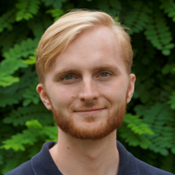

Our Team
Zhizi Wen
Julius Wilps
Tobias Völkel
Omar Fourati

Slide 4



Project Timeline
Milestone
Meeting
Consultation
2022
2023
Nov
Dec
Jan
Feb
Mar
Activity
46
47
48
49
50
51
52
01
02
03
04
05
06
07
08
09
10
11
12
13
WS 22/23
Lecture period
Lecture free period
Milestones
Project Kick-off
Presentation Preliminary Results
Submission Project Report
Final Presentation
Group work
First team meeting
First model prototype
Evaluation/App done
Adidas Guest lecture
Consultation
14.11.2022
16.01.2023
10.03.2023
Today

Slide 5
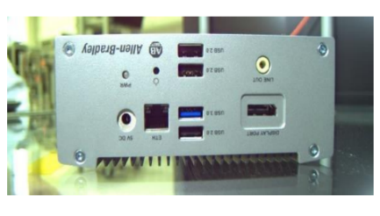
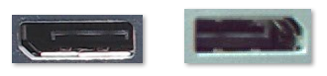
Data Understanding
Goal: Have the most training data of each component in our models
Dataset
535 labeled images in JPEG format
535 label files in XML format
a TXT file with pre-defined classes
Observation
Allen-Bradley boxes appear most often
Most pictures are of the front side
Front side pictures contains 24 classes of components
Components appear in more than one box
Conclusion: Focus on all 24 components on the front sides of all boxes, including 199 images

Slide 6




Quality Inspection Pipeline
A box localization model recognizes the box, then the box is aligned
Components are cropped according to a predefined xml file
A box classification model classifies which box is on the image
Component classification models check if all elements are present
Our goal: Automatic quality inspection of Kontron boxes with high accuracy

Slide 7
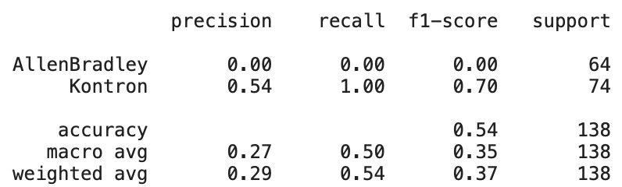
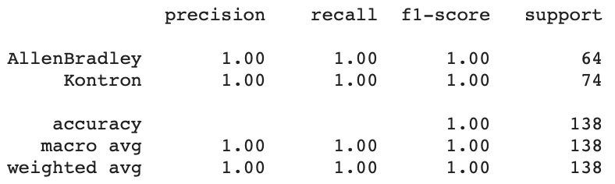
Box Classification
Hand-Crafted CNN
Data
Combine ‘Kontron’ and ‘IPEVO’ samples
Binary classification task
Fine-Tuned ResNet18

Slide 8
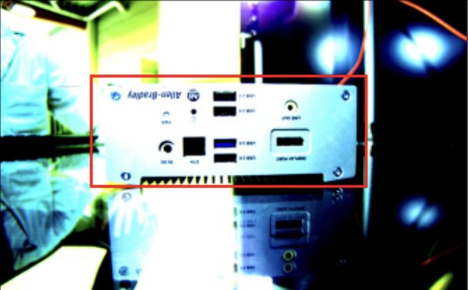
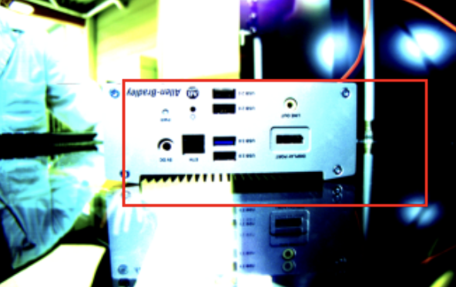
Box Localization
Hand-Crafted Model
Approach
Simple architecture with two convolutional and two fully connected layers
Generally inaccurate performance
Evaluation
Avg. IoU:
0.72
Threshold | Precision | Recall
0.80 | 1.0 | 0.6
0.85 | 1.0 | 0.1
0.90 | 0 | 0
0.95 | 0 | 0
In the test data the maximun IoU is 0.86 and the minimun IoU is 0.46

Slide 9
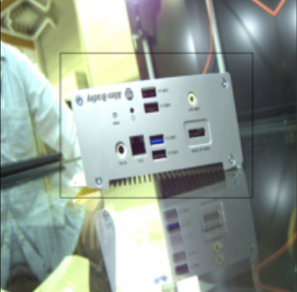
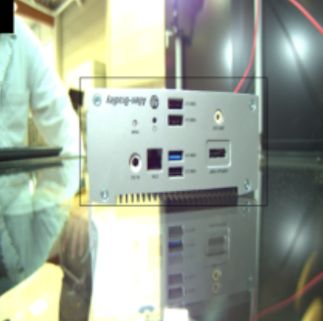
Box Localization
Data Preprocessing
Rotation
Transformations
Rotations
Color Jitter
Normalization
Up to 10 degrees
P = 0.2
Brigness: 0.1
Saturation: 0.1
Hue: 0.1
P = 0.3
According to the traning images of the pretrained network
Color Jitter

Slide 10
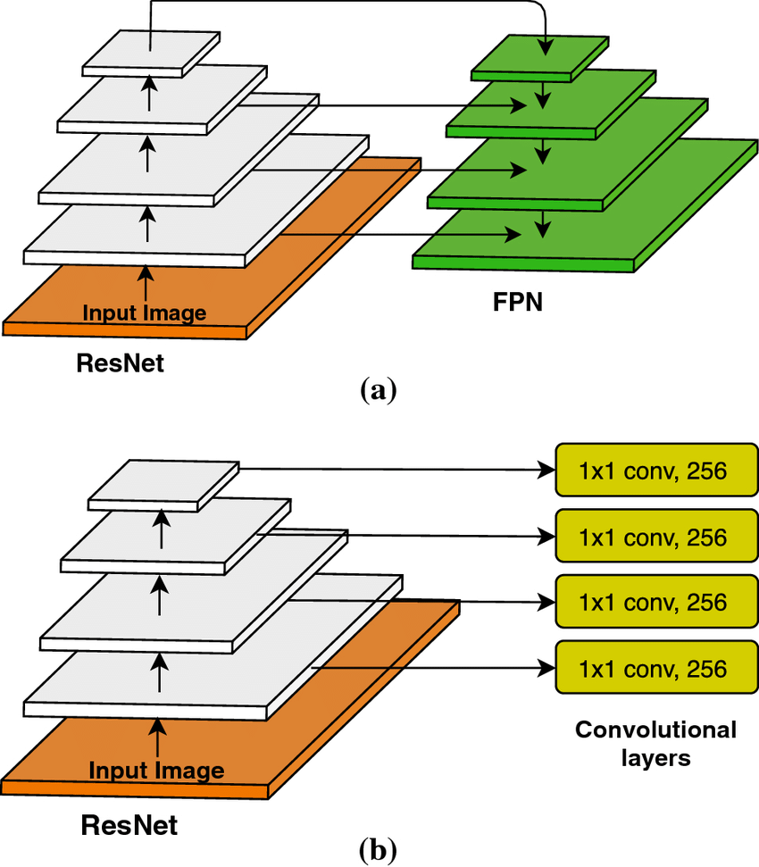
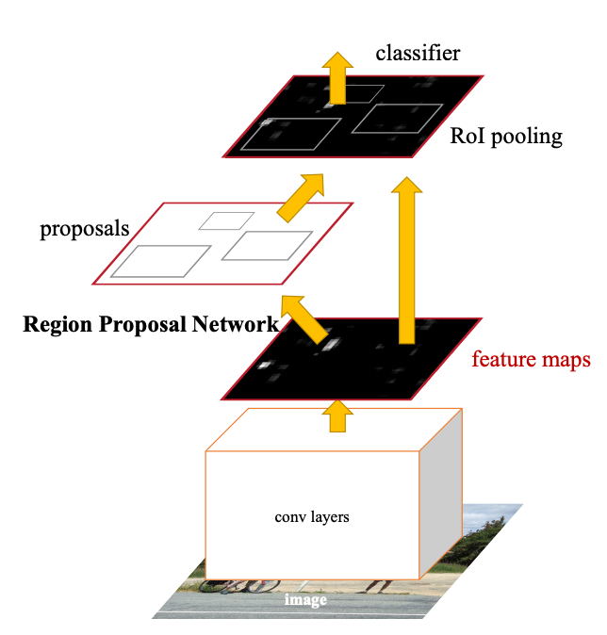
Box Localization
Pretrained Model
Model
CNN Backbone
(ResNet-50 fpn)
Faster RCNN with ResNet50 FPN backbone
Pretrained on the MS coco dataset
Ahmed Et al. 2020
SDG Optimizer; ReLu activation; learning rate: 0.001
Feature Maps
Approach
Train a localizator for Allen-Bradley and Kontron boxes seperately
Faster RCNN
Allen-Bradley
100 epochs
Kontron
50 epochs
Ren Et al. 2017

Slide 11
Box Localization
Evaluation
Allen-Bradley
Kontron
In the test data the maximum IoU is 0.96 and the minimum IoU is 0.86
In the test data the maximum IoU is 0.96 and the minimum IoU is 0.77
Avg.IoU:
0.92
Avg.IoU:
0.88
(in some cases more bounding boxes with a very low confidence where predicted)
(in some cases more bounding boxes with a very low confidence where predicted)
Confidence:
>0.999
Confidence:
>0.999
Recall at Various Thresholds
Recall at Various Thresholds
Threshold | Precision | Recall
0.85 | 1.0 | 1.0
0.90 | 1.0 | 0.55
0.95 | 1.0 | 0.11
Threshold | Precision | Recall
0.85 | 1.0 | 0.91
0.90 | 1.0 | 0.45
0.95 | 1.0 | 0.09

Slide 12
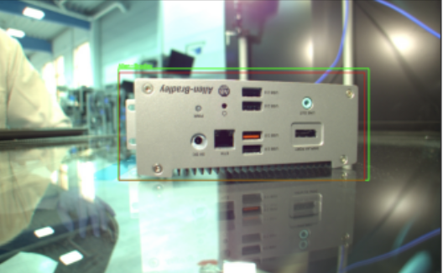
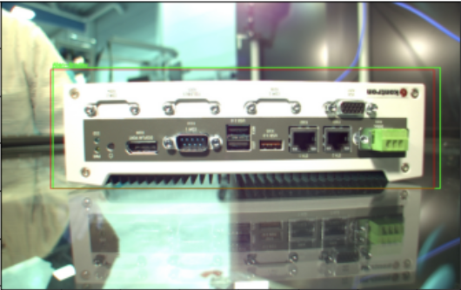
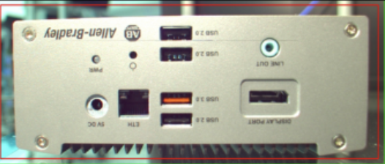
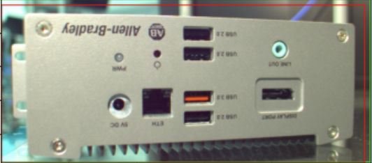
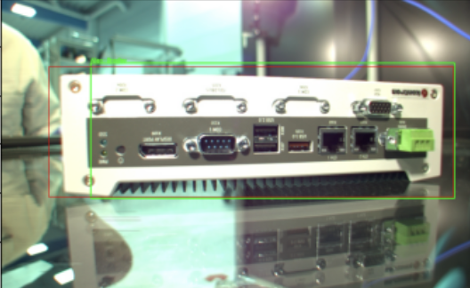
Box Localization
Evaluation
Allen-Bradley
Kontron
Red bounding box: Ground Truth
Green bounding box: Prediction

Slide 13
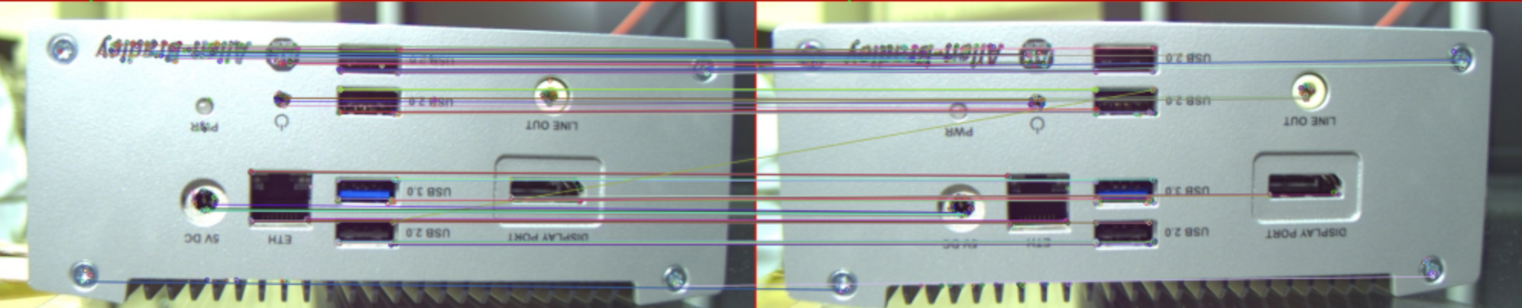
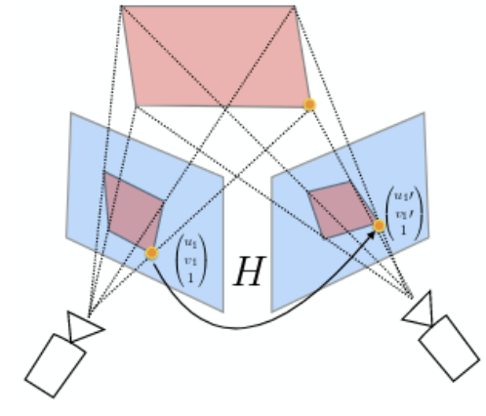
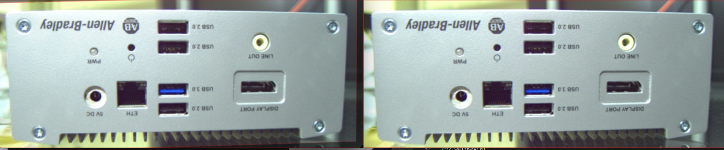
Box Alignment
Evaluation Kontron
Approach
Define a template
Find keypoints
Match the keypoints
Calculate homography
Warp image
Open CV library
ORB (Oriented FAST and Rotated BRIEF)
Keypoint detection
and mapping
Hamming method
Keypoint matching
Homography estimation
RANSAC (Random Sample Consensus)

Slide 14
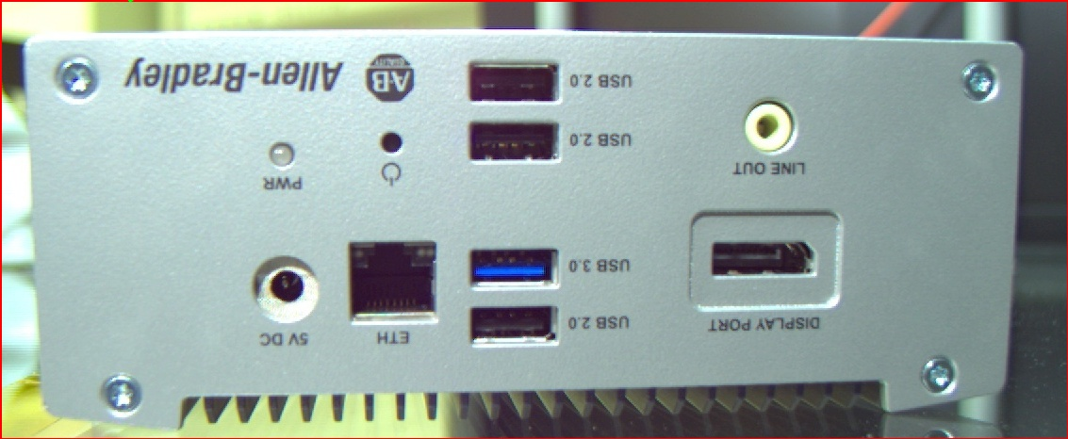
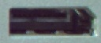
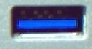



Data Preparation: Components
For Classification Training and Inference
Crop components using labelled XML file
Cropping
199 front-view images
Extract label and coordinates from XML file
Crop each component
Components
4,762 images
24 distinct components
Binary classification:
Split into ‘component’ and ‘other’ class
…

Slide 15
Component Classification
Multi-Class Classification
Multi-Class Classification
Classify component into one of 24 classes
Evaluation
Weighted Average F1-Score
?
USB_3
Hand-Crafted: 90%
Transfer Learning (ResNet18): 96%
Display_Port
Ethernet
…

Slide 16
Component Classification
Binary Classification
Binary Classification
Classify component into one of two classes
Evaluation
Mean of Weighted Average F1-Scores
Hand-Crafted: 86%
Transfer Learning (ResNet18): 96%
?
USB_3
Other

Slide 17
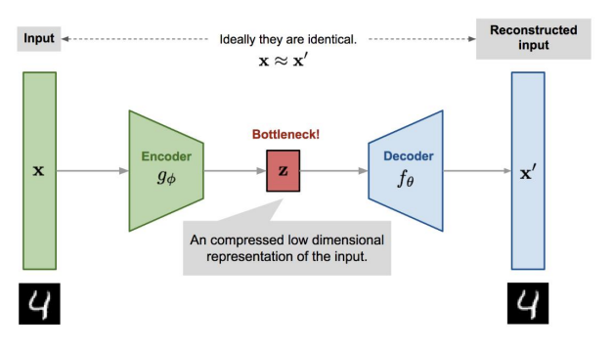
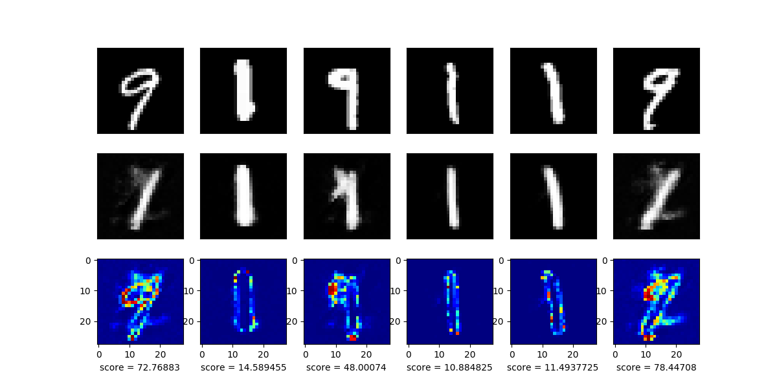
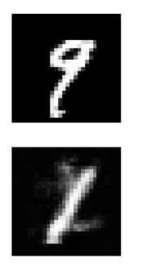
Component Anomaly Detection
Theory of Autoencoder Models
Theory
Application
How can it be used in our case?
If an autoencoder model has learned patterns from one component, it can reconstruct this component well. However, this model can reconstruct other components badly.
Example
An autoencoder is comprised of two networks.
Encoder: Converts the input images into latent low-dimensional code
Decoder: Recovers the data from the code
Ideally, the reconstructed images are identical to the input images.
Input
Output
Reconstructing Normal images
Reconstructing Anomal images

Slide 18


Component Anomaly Detection
Data Preprocessing
1. Use similar data as for binary image classification model
70% Train data
20% Validation data
10% Test data
Component to classify
Other components
Component to classify
Other components
Component to classify
Other components
2. Resize the images to 28 x 28 pixels
3. Turn the images into greyscale
4. Normalize their colors

Slide 19
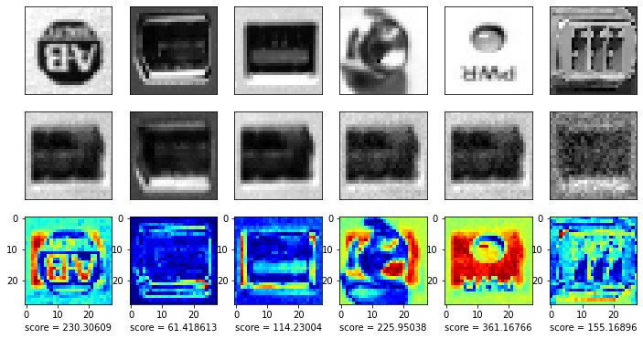
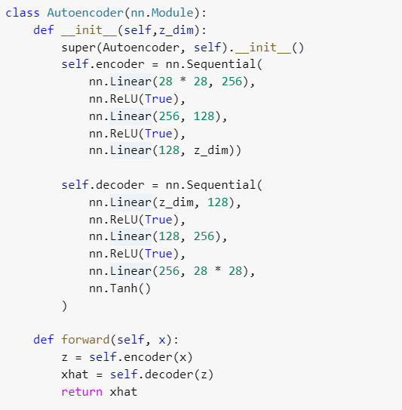
Component Anomaly Detection
Train the Autoencoder Models for our Tasks
Train
Threshold Determination
Define an autoencoder class
Normal
Abnormal
z_dim = 64
batch_size = 16
num_epochs = 10
learning_rate = 3.0e-4
mse_loss = nn.MSELoss()
The average sum of difference in pixels in normal images is used as a threshold to identify anomalies

Slide 20
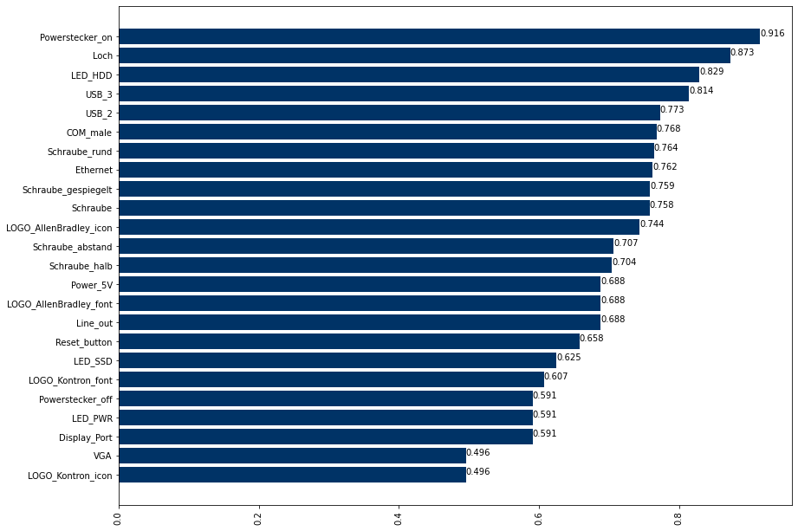
Component Anomaly Detection
Evaluate the Threshold on Test Images
Evaluation: Weighted avg F1-scores of autoencoder models
The model for Powerstecker_on has performed the best, with a weighted avg F1 of 0.916.
The models for LOGO_Kontron_icon and VGA have performed the worst, with a weighted avg F1 of 0.496.
The mean of weighted avg F1-scores is 0.7.
Notes:
As a result, we have on average weighted avg F1 scores 0.7. But there is a large difference in each component. While model Powerstecker_on has reached a score of 0.916, the worst model‘s score is less than 0.5.

Slide 21
Discussion
Comparison of evaluation results on three techniques
Observation
Binary and multi-class classifier are in general better than anomaly detection model.
Among binary classifier and multi-class classifier, hand-crafted models generally perform worse than models with transfer learning.
0
0
We chose pre-trained binary classification models for deployment.
Binary classifier performs well on every component
Easier to implement
Notes:
To sum it up, binary classification and multiclass classifier both perform better than anomaly detection model. And pretrain resnet18 model performs better than hand-crafted approach. This result is probably due to difference amount of training data, and model with larger amount of training data performs better.
At the end, we use pre-train binary classification models for deployment. Because Binary classifier performs well in every component and is Easier to implement

Slide 22


Deployment – The Application
Goal: Create a dashboard/frontend for the end user
Framework ?
Best and most efficient
Easy to code and to implement
Supports use of advanced AI Models
Structure / Architecture ?
What and how to show ?
Focus on AI Models implementation or UI
Follow code structure
Local deployment first

Slide 23
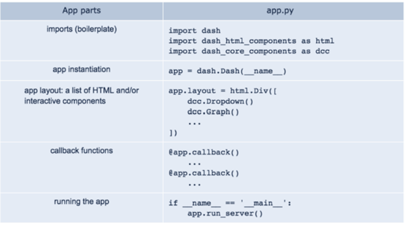
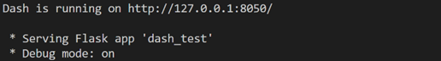
Deployment – The Application

Slide 24
Deployment – The Application
Upload box image (Step 1)
Structure
Box classification (Allen-Bradley or Kontron) (Step 2)
e
Linear structure
Top-down logic
Following the workflow of project
Code easy to implement
Relevant information communicated
Box localization and image cropping with bounding box and alignment (Step 3)
Perform classification of hardware components (Step 4)

Slide 25
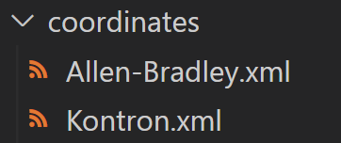
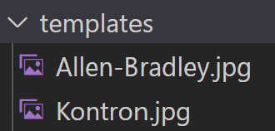
Deployment – The Application
Step 1
Step 3
Read xml coordinates depending on class of image:
Box image upload
Will be the Input for the next steps
Upload function of Dash
Prediction of bounding box, alignment based on class
Step 2
Classifier 1
Output the aligned and cropped image in the webapp
Image is stored in a temporary folder for next step
Allen-Bradley Box
Kontron Box
Output Image and detected class

Slide 26
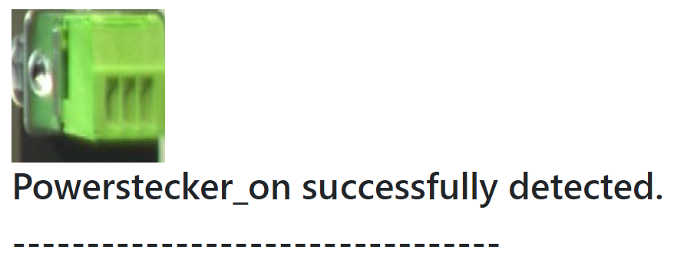
Deployment – The Application
Step 4
Classification of hardware elements
Classifier as helper function with two parameters : Image and xml file
1 = predicted class , 0 = other class than expected one
Translate results for the frontend
A loop goes through each hardware element and outputs classification of that element

Slide 27
Summary and Outlook
Summary
Box localization and alignment for two types of boxes, classification
Classification of 24 different components and two types of boxes
Multiple classification methods: Multi-class, binary and anomaly detection
Hand-crafted models vs Transfer learning
Different data augmentation
Web-App
Outlook
Top and back view
XAI methods
Improve User Interface of the webapp
Implement key facts and numbers of AI Models in App( Accuracy, Scores .. )
Test use of the models and App in the business environment
Notes:
Summary:
Different classification approaches (multi-class, binary and anomaly detection)
Differentiation between different types of boxes
24 different hardware features can be classified
Localization and alignment of different types of boxes
Hand crafted vs transfer learning
Pipeline integration in app
Outlook:
Better UI
Top and back view
XAI methods
Test in business environment

Slide 28
Feedbacks and Questions

Slide 29
References
Ahmed, B., Gulliver, T. A., and alZahir, S. 2020. “Image splicing detection using mask-RCNN,” Signal, Image and Video Processing (14:5), pp. 1035–1042 (doi: 10.1007/s11760-020-01636-0).
Ren, S., He, K., Girshick, R., and Sun, J. 2017. “Faster R-CNN: Towards real-time object detection with region proposal networks,” IEEE Transactions on Pattern Analysis and Machine Intelligence (39:6), pp. 1137–1149 (doi: 10.1109/tpami.2016.2577031).

Slide 30
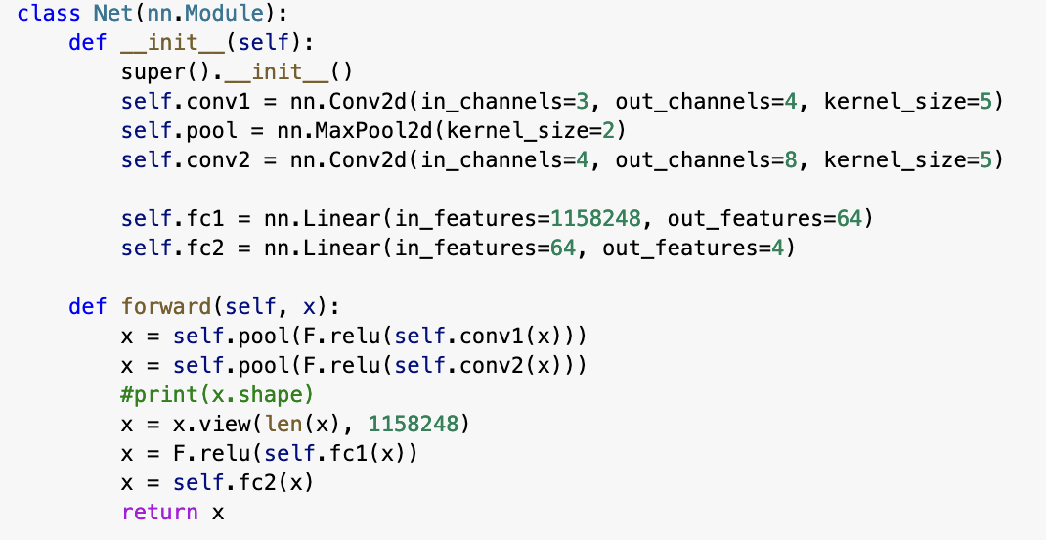
Appendix
Architecture Hand-Crafted Localization Model
Two convolutional and two fully connected layers
Kernel size: 5
Adam Optimizer
ReLu activation function

Slide 31
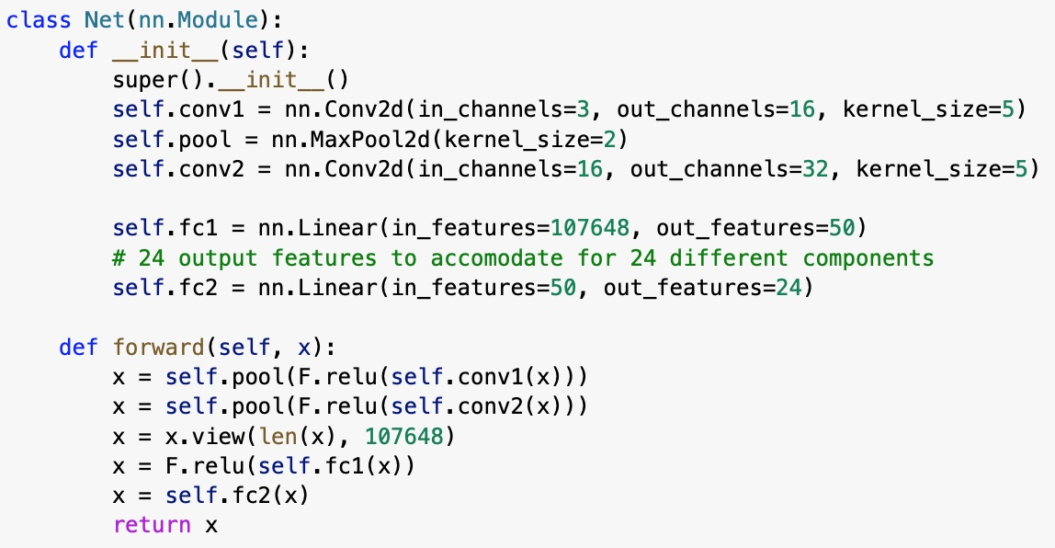
Appendix
Classification
Data
Training Data (70%)
Validation Data (20%)
Test Data (10%)
Transformations
Training
10 Epochs
Adam Optimizer
Learning Rate 3e⁻⁴
(Binary) Cross-Entropy Loss Fct

